Slide 1
TO OUR VIRTUAL LIVE DISCUSSION
CHATHAM TO LAKESHORE LINE PROJECT

Slide 2
TONIGHT’S AGENDA
Project overview
Update on Class Environmental Assessment process
Route alternative refinements
Key milestones and next steps
Live Q&A session
2

Slide 3
HOW TO PARTICIPATE TONIGHT
Press 3 on your telephone at any time to ask a question Type a question in the submission box on the right hand side
3

Slide 4
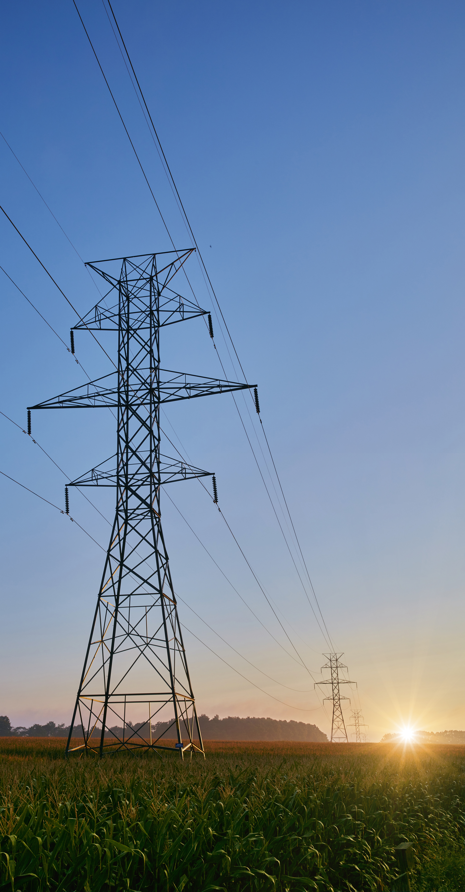
PROJECT OVERVIEW
A safe and reliable power supply is essential to ensure southwestern Ontario can continue to grow now and into the future.
In June 2019, the Independent Electricity System Operator (IESO) requested Hydro One build a new double-circuit 230 kilovolt transmission line from the Chatham Switching Station to the future Lakeshore Switching Station.
This project requires undertaking a Class Environmental Assessment which began in January 2020.
It is anticipated this line will be in-service prior to the end of 2025.
4
Notes:
What’s changed:
- Removal of second sentence in first paragraph

Slide 5
HOW THE NEW LINE WILL SUPPORT THE REGION
As businesses and industry continue to expand in the region, so does the need for more electricity.
The new high voltage transmission line will support the region by:
Ensuring critical infrastructure is in place to keep southwestern Ontario one of North America’s agricultural hubs
Improving reliability for homes and businesses including both Hydro One and local distribution customers
Connecting more people and industry to the grid by bringing enough energy to power a city the size of Windsor to the area
Supporting the local economy by creating new direct and spin off jobs and training opportunities as one of the largest electricity infrastructure projects in the region
5

Slide 6
CLASS ENVIRONMENTAL ASSESSMENT
The Class Environmental Assessment (Class EA) for Minor Transmission Facilities sets out a planning and decision-making process for projects with predictable environmental effects that can be mitigated.
6

Slide 7
INITIAL ROUTE ALTERNATIVES
To view our interactive map, please visit:
www.arcg.is/1PKL1n
7
Notes:
Since initiating a Class EA in January, Hydro One has been conducting technical and environmental studies and engaging with residents, First Nations communities, and representatives from federal and provincial agencies, Municipal staff, and interest groups.
Through our technical reviews and feedback received, we have developed a more in-depth understanding of the study area for each of the route alternatives.
Based on what we have learned, Hydro One has made four refinements to our route alternatives and has identified the need to expand our Chatham Switching Station to the east on our existing lands, due to technical and environmental constraints and requirements. Further details can be found on maps tab below.

Slide 8
ENGAGEMENT & FEEDBACK HEARD
Hydro One is committed to ongoing engagement and consultation. To date we’ve:
Held 2 virtual information sessions with community members reaching more than 4,000 households.
Held 2 virtual information sessions with First Nations communities reaching more than 200 households.
Held 2 virtual Technical Advisory Committee workshops with provincial and federal agencies, First Nations community representatives, and technical and industry stakeholders.
Corresponded via phone or email with more than 100 community members.
Organized regular and frequent engagement with local elected officials.
Engaged with eight First Nations communities.
Distributed more than 60,000 flyers.
KEY FEEDBACK WE’VE HEARD:
Protecting agricultural features should be considered when both selecting the route and designing the line.
Farming practices should be considered as part of the solution used to deliver this project.
The former rail corridor should be reconsidered as a potential route alternative.
8
Notes:
Changes in red/green
Removed last sentence in the Key Feedback We’ve Heard Section

Slide 9
TECHNICAL WORK & DISCOVERIES
Our team has performed background research and conducted field surveys on each of the route alternatives. To date we’ve:
Collected natural heritage information.
Reviewed municipal official plans.
Completed a Stage 1 archaeological assessment and cultural heritage existing conditions study.
Conducted environmental field surveys for ecological land classification, vegetation inventory, aquatic habitat, breeding birds and species at risk habitat.
Conducted an in-depth reassessment of the former rail corridor, including site reconnaissance, as a potential route alternative based on project feedback.
WHAT WE’VE LEARNED:
Better understanding of the natural and socio-economic environment within the study area.
Certain setback distances from the Highway 401 corridor and interchanges, provided by the Ministry of Transportation, must be maintained.
The former railway corridor presents a number of constraints deeming it not sufficient as an route alternative for the project.
Additional constraints posed by other utilities in the region must be considered.
9

Slide 10
HOW HAS THIS SHAPED THE PROCESS?
The feedback received and the information captured have informed the Class Environmental Assessment process by:
Expanding our overall knowledge and understanding of the local areas.
Identifying a need to make four refinements to the route alternatives we are studying.
Establishing the criteria that will be used to evaluate the route alternatives and ultimately select a preferred one.
Identifying a potential list of measures to avoid, mitigate and/or restore environmental effects when building the line.
10

Slide 11
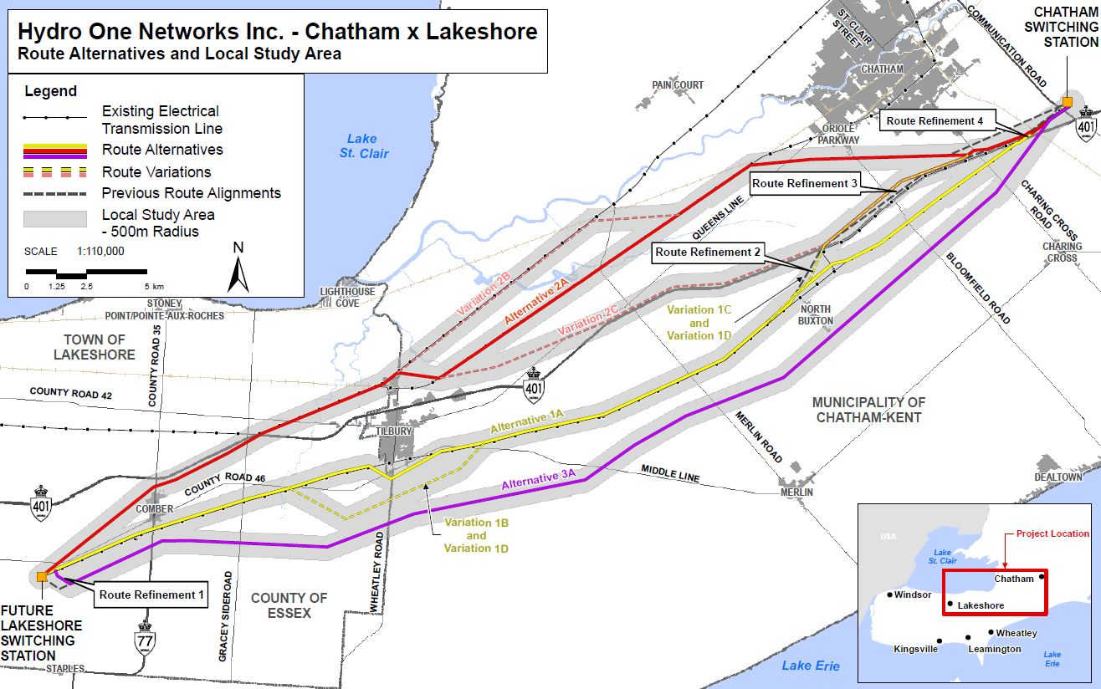
REFINED ROUTE ALTERNATIVES WE ARE EVALUATING
To view our interactive map, please visit:
www.arcg.is/1PKL1n
11

Slide 12
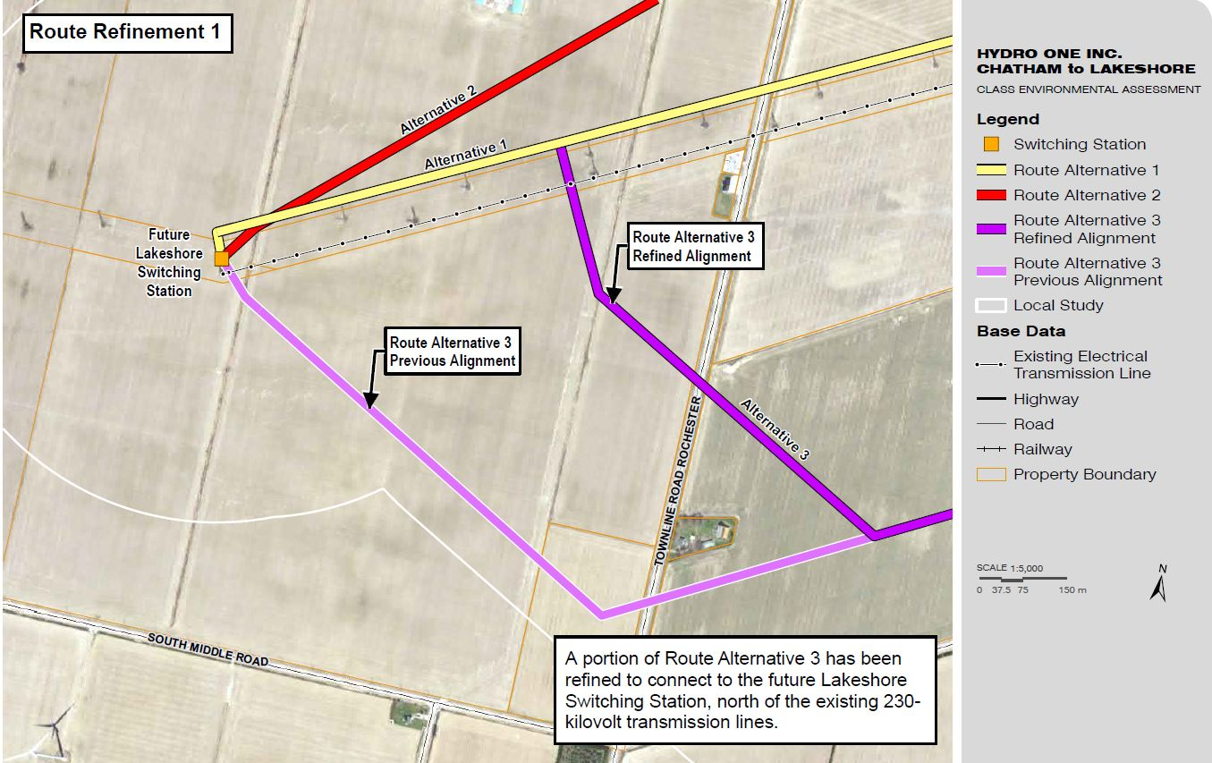
Route Refinement 1
12

Slide 13
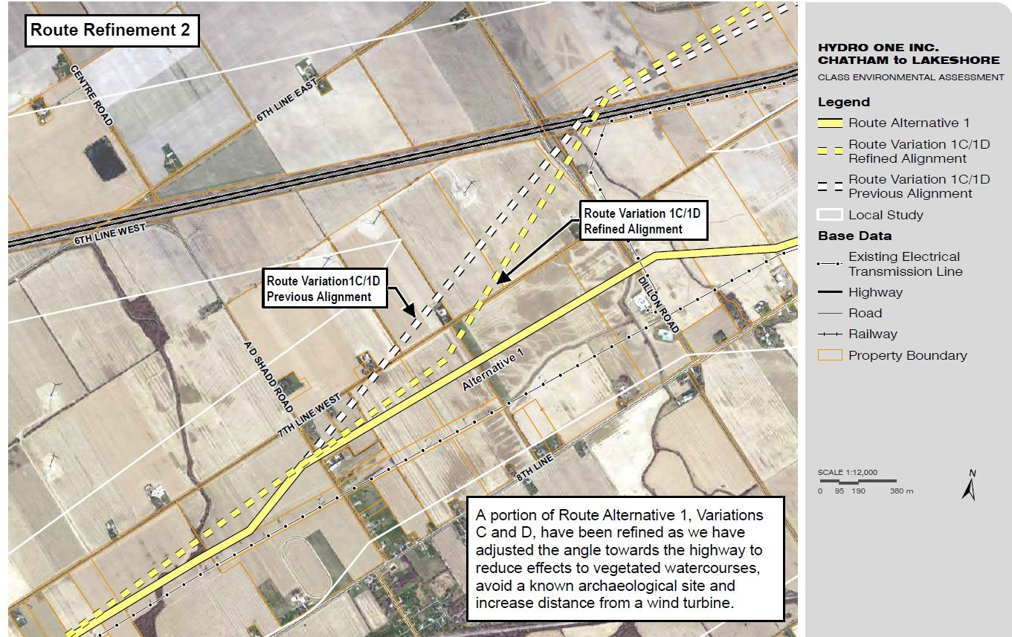
Route Refinement 2
13

Slide 14
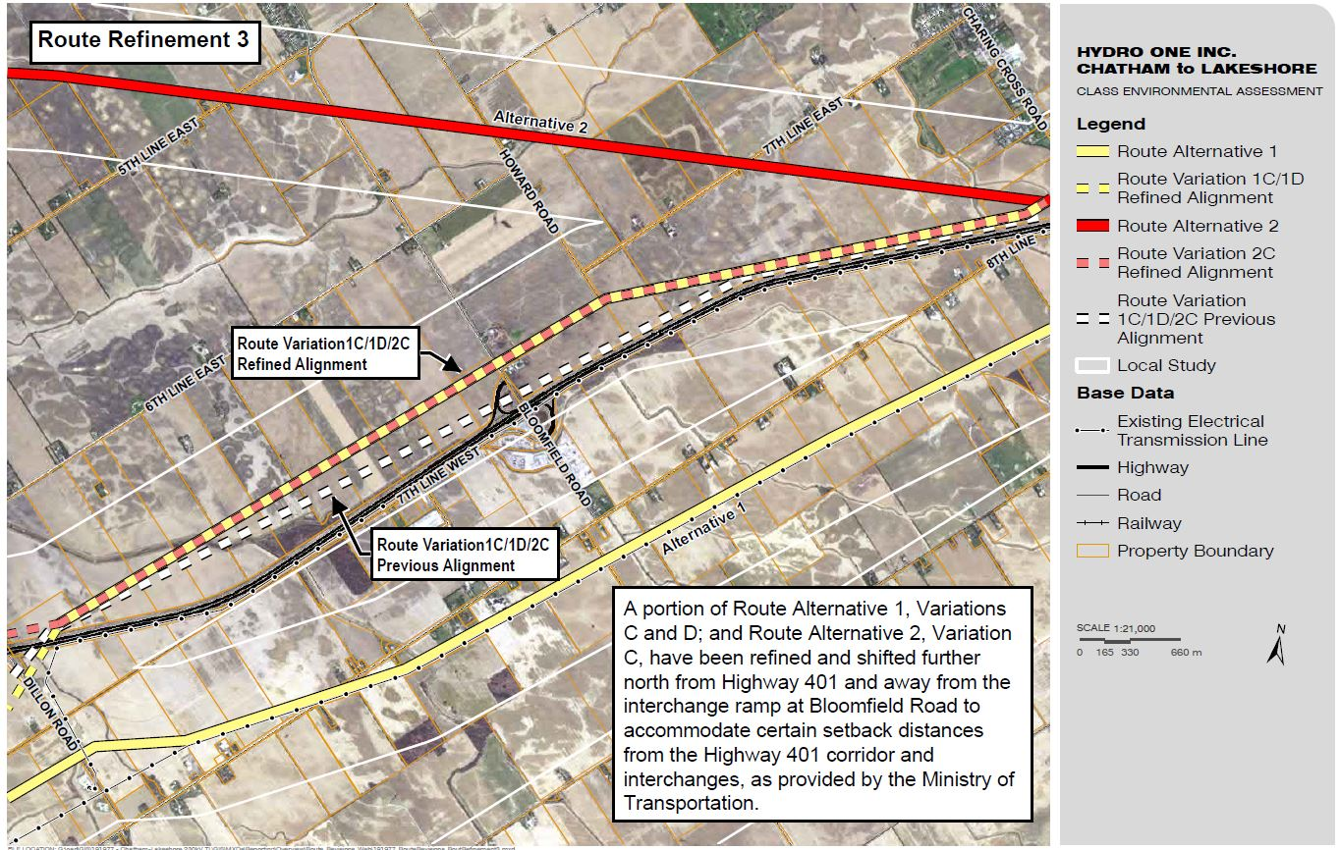
Route Refinement 3
14

Slide 15
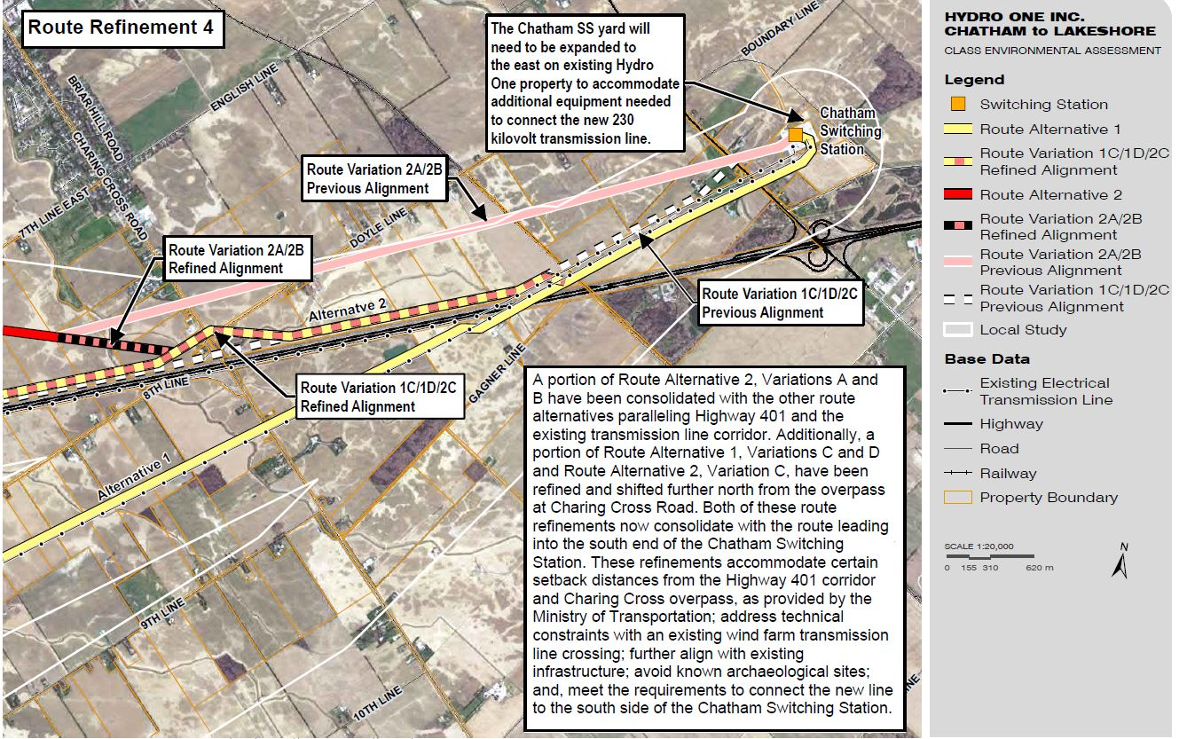
Route Refinement 4
15

Slide 16
EVALUATION OF ROUTE ALTERNATIVES
CATEGORIES
Using the feedback that we have received to date, as well as the detailed environmental and technical assessments we have conducted, Hydro One has developed the list of criteria under four categories that will be used to evaluate each of the route alternatives in order to select a preferred route.
Over the next few months, we will be using a weighted Multi-Criteria Decision Making (MCDM) analysis method to inform our decision-making. Including assigning relative weighting to each criteria measure and evaluating and selecting the preferred route.
16
Notes:
Presentation will refer to where they can find the full criteria list

Slide 17
ROUTE EVALUATION CRITERIA
Land use designations
Future land use designations
Agricultural operations
Petroleum operations
Commercial/industrial buildings, properties, site plans or business operations/supply chains
Cultural resources
Residential buildings, properties or site plans
Source water protection
Archaeological resources
Aggregate resources extraction areas/operations (pits/quarries)
Fish and aquatic habitat
Vegetation
Terrestrial and wildlife habitat
Species at risk & species of conservation concern
Natural hazards, wetlands and floodplain areas
Designated natural areas
Line length
Line angles
Crossings
Parallel and adjacent to underground pipelines
Proximity to wind turbines
Parallel and adjacent to existing transmission corridor
Parallel and adjacent to other existing infrastructure (e.g., Highway 401)
Number of properties requiring new real estate rights
Number of mandatory property acquisitions
First Nations traditional/contemporary lands and resources uses and occupation
17

Slide 18
PROJECT MILESTONES
18

Slide 19
LIVE QUESTION PERIOD
Panelists
Daniel Levitan Vice President of Stakeholder Relations
John Chadwick Manager, Environmental Services
Andrew Luis Senior Real Estate Coordinator
Sanjiv (Sonny) Karunakaran Director, Project Delivery
Sara Jane Souliere Senior Advisor, Indigenous Relations
If we didn’t get to your question during tonight’s discussion, please contact us:
View our interactive map:
www.arcg.is/1PKL1n
Visit our virtual open house:
chatham-to-lakeshore-openhouse.com
19

