Slide 1

TO OUR VIRTUAL LIVE DISCUSSION
CHATHAM TO LAKESHORE LINE PROJECT

Slide 2
TONIGHT’S AGENDA
Project and Class Environmental Assessment process update
Route evaluation process and selection of the preferred route alternative
Ongoing engagement
Next steps
Live Q&A session
2

Slide 3


HOW YOU CAN PARTICIPATE TONIGHT
Press 3 on your telephone at any time to ask a question
Type a question in the submission box on the right hand side
3

Slide 4

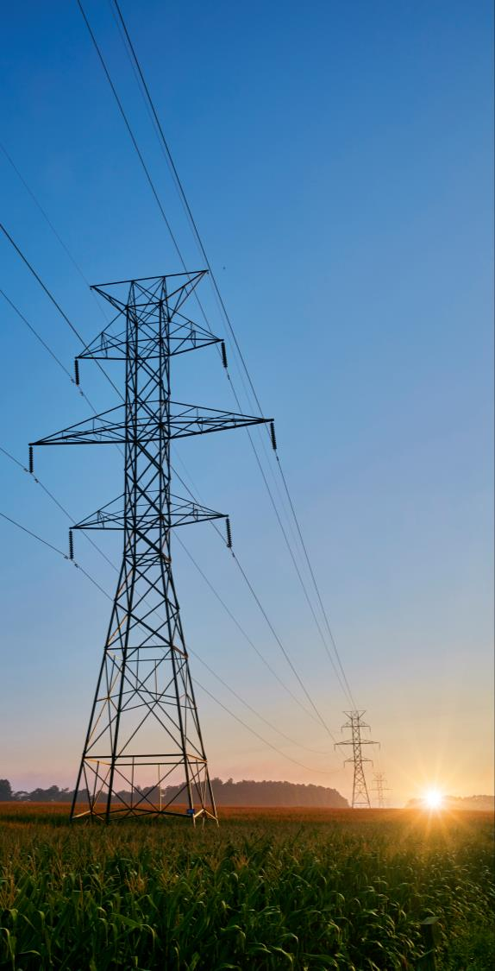
PROJECT OVERVIEW
A safe and reliable power supply is essential to ensure southwestern Ontario can continue to grow now and into the future.
In June 2019, the Independent Electricity System Operator (IESO) requested Hydro One plan and build a new double-circuit 230 kilovolt transmission line from the Chatham Switching Station to the future Lakeshore Switching Station.
This project requires undertaking a Class Environmental Assessment (Class EA) which began in January 2020.
Through the Class EA process, our team assessed several route alternatives, and based on information gathered and feedback received, Route 2A has been selected as the preferred route.
It is anticipated this line will be in-service between 2024 to 2025.
4
Notes:
Don’t like that line about working w/people of Ontario
Phrase it as a reminder

Slide 5




HOW THE NEW LINE WILL SUPPORT THE REGION
As businesses and industry continue to expand in the region, so does the need for more electricity.
The new high voltage transmission line will support the region by:
Ensuring critical infrastructure is in place to keep southwestern Ontario one of North America’s agricultural hubs.
Improving reliability for homes and businesses, including both Hydro One and local distribution customers.
Connecting more people and industry to the grid by bringing enough energy to power a city the size of Windsor to the area.
Supporting the local economy and communities by creating new direct and spin off jobs, as well as training opportunities as one of the largest electricity infrastructure projects in the region.
5
Notes:
Transition it more friendly

Slide 6
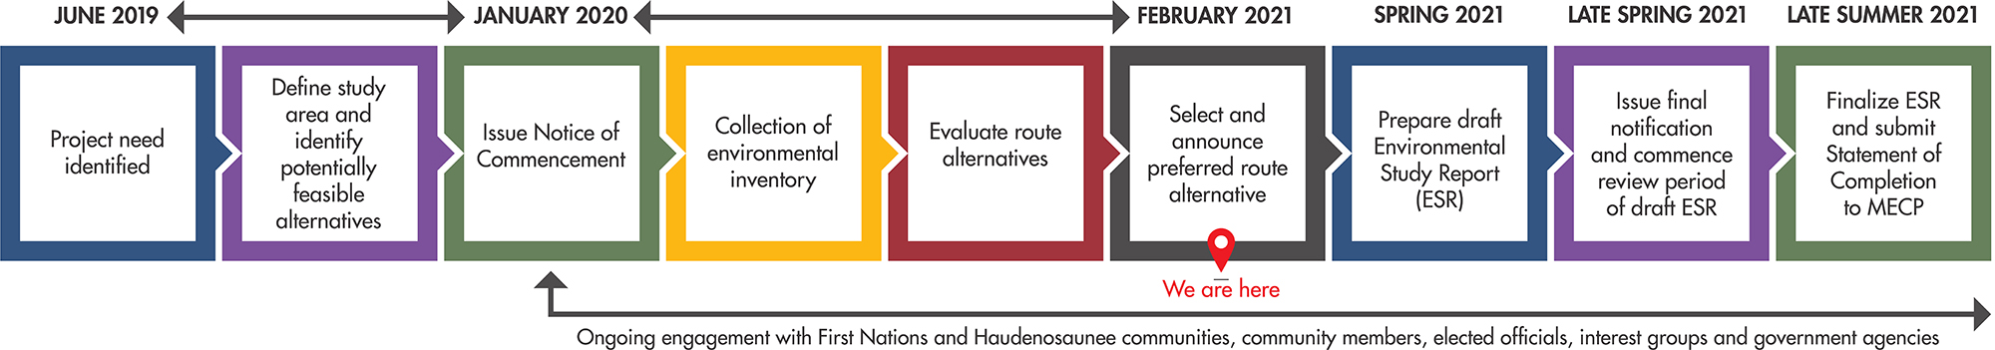
CLASS ENVIRONMENTAL
ASSESSMENT PROCESS UPDATE
6
Notes:
Phrase it as a reminder

Slide 7

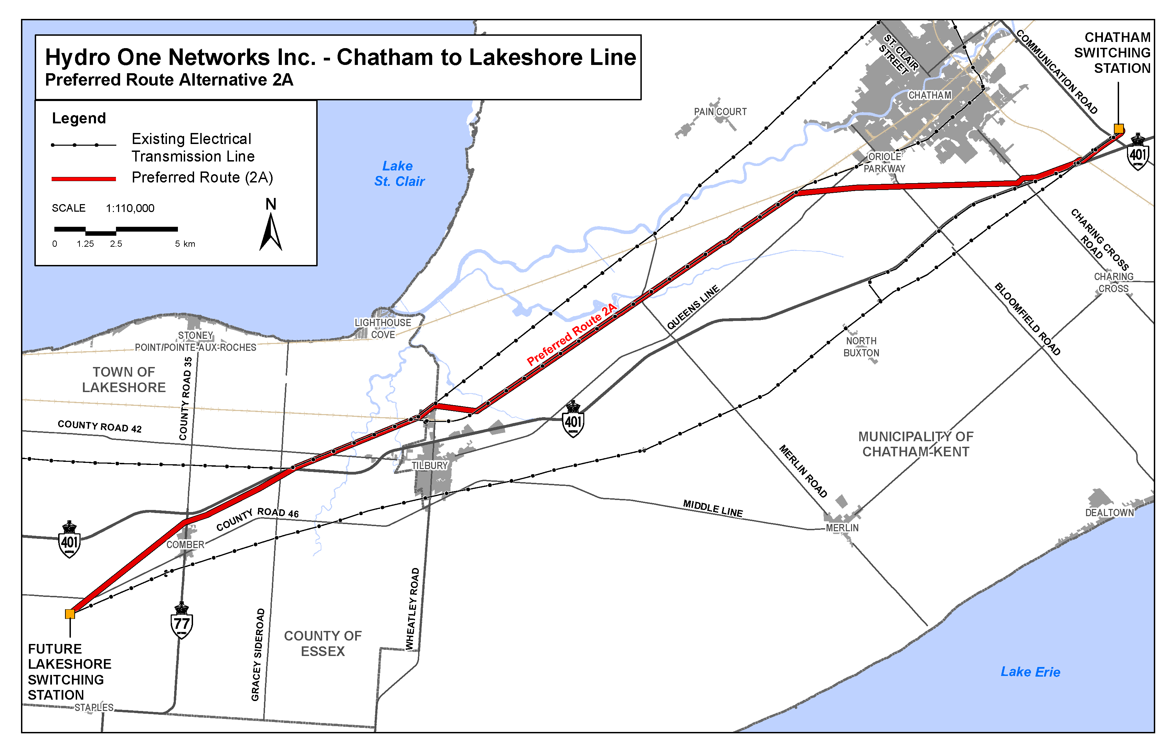
PREFERED ROUTE ALTERNATIVE
For a detailed look, view our interactive map at:
www.arcg.is/1PKL1n
7
Notes:
Don’t say slides –

Slide 8




EVALUATION OF ROUTE
ALTERNATIVES
EVALUATION CATEGORIES
The route evaluation process used to compare the advantages and disadvantages of each route consisted of collecting feedback from First Nations and Haudenosaunee communities, community members and stakeholders, as well as available information across the four adjacent categories.
Using this feedback and information collected, we established an evaluation framework, which included:
    Identifying a wide variety of evaluation criteria under each category; and
    Assigning a relative weight (level of importance) to each criterion.
Each route was evaluated fairly and holistically resulting in the selection of a preferred route alternative.
8
Notes:
Don’t say “seen on the screen”

Slide 9
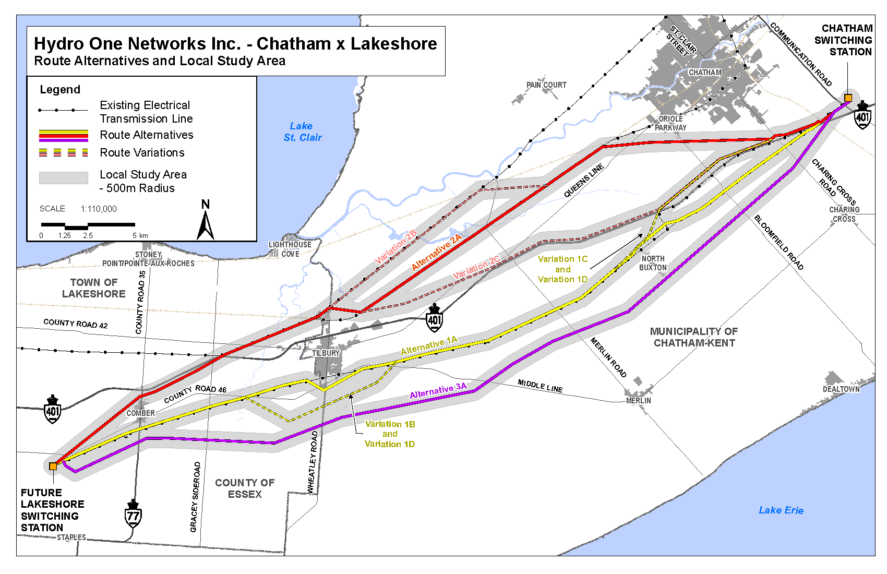
ROUTE ALTERNATIVES ASSESSED
At the start of the project, we identified viable route alternatives, each with their own distinct advantages and disadvantages.
In October 2020, we made four refinements to the routes based on technical and environmental information learned.
9
Notes:
- I want to talk about how we arrived at this selection.

Slide 10
INCORPORATING FEEDBACK
Ensuring that local feedback and knowledge was incorporated and reflected in the route selection process was a key priority.
SOME OF THE FEEDBACK WE HEARD:
Effects to agricultural operations should be a key consideration.
Opportunities to both repurpose existing utility corridors and parallel with other linear infrastructure should be prioritized.
Certain setback distances from the Highway 401 corridor and interchanges, provided by the Ministry of Transportation, must be maintained.
Proximity to First Nation and Haudensouanee areas that support fishing, hunting and trapping, as well as identified areas of historical significance, should be considered.
Effects to the natural environment, in particular effects
to habitat for species-at-risk and significant terrestrial/wildlife should be considered.
KEY ENGAGEMENT ACTIVITIES:
Community and Property Owners
  Held 2 virtual live discussions session in May and November last year, reaching more than 1000 participants per each event
  Launched a virtual open house
  Corresponded and/or met with more than 100 community members
Technical Stakeholders
  Held 2 Technical Advisory Committee virtual workshops and organized ongoing conversations with agencies, municipal staff, industry and other technical stakeholders
First Nations and Haudenosaunee
  Hosted virtual live discussions and route evaluation workshops
  Organized opportunities to review natural environment information
10
Notes:
. Do we mention First Nations when we talk about the different groups that we have met with?

Slide 11
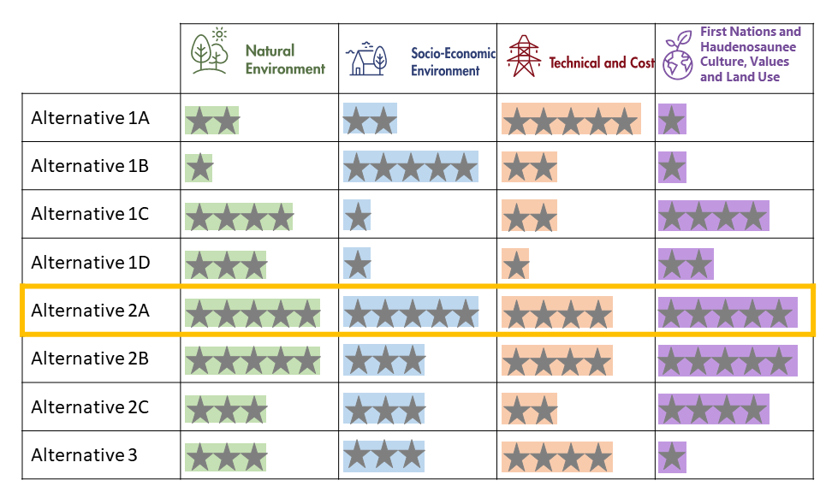
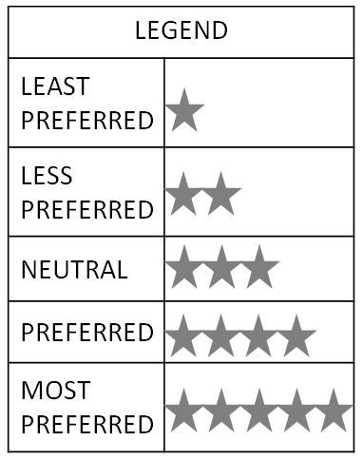
SUMMARY OF EVALUATION
11

Slide 12



PREFERRED ALTERNATIVE 2A
Based on a year-long consultation and evaluation process, Alternative 2A has been selected as the preferred route. This route allows us to repurpose approximately 16 kilometers – roughly 1/3rd of the route length – of an existing idle transmission corridor, minimizing effects to the natural and socio-economic environment, as it reduces the need for a new transmission right-of-way.
Compared to other route alternatives, overall Alternative 2A:
Effects the fewest aquatic resource areas
Crosses a low amount of incompatible vegetation
Has low overall impacts to potential species-at-risk habitat
Minimizes effects to agricultural operations
Crosses few features associated with Archaeological potential
Avoids a National Historic Site of Canada (NHSC)
Maximizes the renewal of existing infrastructure by repurposing an idle transmission line corridor
Crosses the fewest property parcels and farms
Follows additional linear infrastructure, such as the Highway 401 and other energized transmission lines
Balances the proximity to areas of historical significance identified by First Nations and Haudenosaunee with the co-location of existing infrastructure and minimal effects to natural environment features.
12
Notes:
More conversational tone here
Change FN wording

Slide 13
WORKING WITH LANDOWNERS
ALONG ROUTE 2A
Starting tomorrow, a dedicated real estate representative will be in contact with landowners to schedule a meeting.
This will be a first step as we work closely with landowners whose property will be traversed by the preferred route.
During these meetings, representatives will review Hydro One’s next steps in this process and introduce our project-specific Land Acquisition Compensation Principles.
13

Slide 14



KEY LAND ACQUISITION COMPENSATION PRINCIPLES
Our Land Acquisition Compensation Principles will be used as the roadmap to guide our conversations with landowners traversed by the preferred route. These principles have been tailored to local characteristics and feedback we’ve heard to date from the community.
Some of the key principles include:
Landowners will be offered the choice of Hydro One acquiring either an easement or the fee simple interest (ownership) in the lands required for the project corridor.
Offers will be based upon site specific appraisal reports prepared by independent third party AACI appraisers.
Monetary incentives, in addition to market value compensation, will be offered for the conveyance of voluntary property rights.
Construction impact will be mitigated to the extent feasible, and reimbursement for cropland out of production during and after construction and any physical damages that are unable to be mitigated, will be provided.
14
Notes:
Design width seems a bit awkward here

Slide 15
ADDITIONAL NEXT STEPS
As we move into this next stage of the project, we remain committed to working with individual landowners, ensuring our team is available every step of the way.
Over the next several months, we will complete next steps in the Class Environmental Assessment process and plan for the design and construction of the new line. Our efforts will focus on continuing to work with landowners and community members by:
Engaging directly with landowners along Route Alternative 2A as we seek voluntary property rights.
Collecting and gathering information to advance the design and construction solution.
Seeking local landowners knowledge, understanding and expertise to help plan for construction by identifying additional measures and considerations to avoid, mitigate, or restore potential environmental effects on lands which will traverse the preferred route.
Preparing a draft Environmental Study Report (ESR) which will be shared for a review and comment period.
15

Slide 16
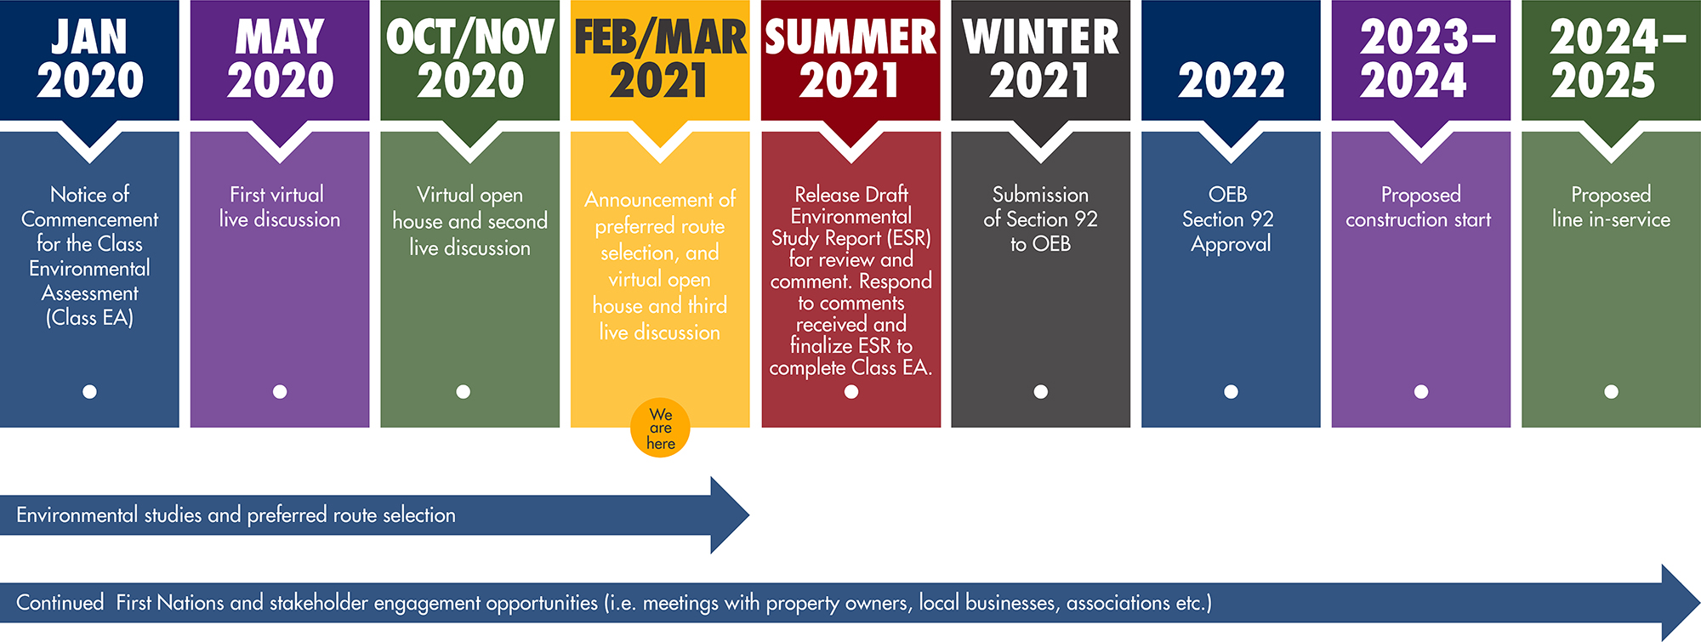
PROJECT MILESTONES
*
*
*
*
*In order to meet the energy needs of the region as quickly as possible, we are looking for opportunities to advance the construction start time to bring the new line into service at an earlier date.
16

Slide 17
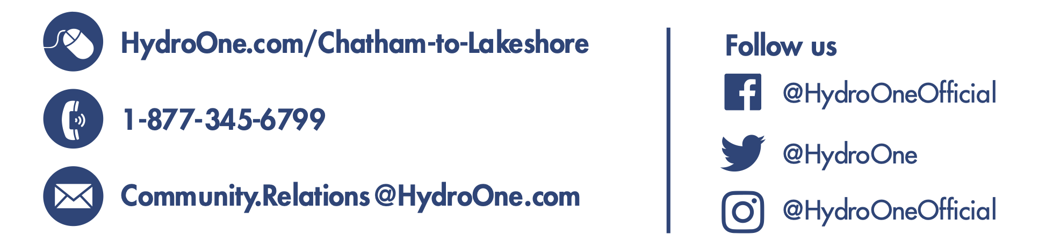

LIVE QUESTION PERIOD
Panelists
Daniel Levitan
Vice President of Stakeholder Relations
John Chadwick
Manager, Environmental Services
Andrew Luis
Senior Real Estate Coordinator
Sanjiv (Sonny) Karunakaran
Director, Project Delivery
Sara Jane Souliere
Senior Advisor, Indigenous Relations
If we didn’t get to your question during tonight’s discussion, please contact us:
View our interactive map:
www.arcg.is/1PKL1n
Visit our virtual open house:
chatham-to-lakeshore-openhouse.com
17

