Slide 1

TILLSONBURG STATION AND LINE REFURBISHMENT
PROJECT

Slide 2
Overview
  Welcome to Hydro One’s online information presentation on upcoming work at our Tillsonburg Transformer Station.
  Through this narrated presentation, you will learn more about:
  The proposed project;
  What community members can expect during construction;
  Replanting opportunities and;
  Project timelines.
  Any feedback or questions you have can be sent to Community.Relations@HydroOne.com, or you can leave us
  a message at 1-877-345-6799 and we will return your call.

Slide 3
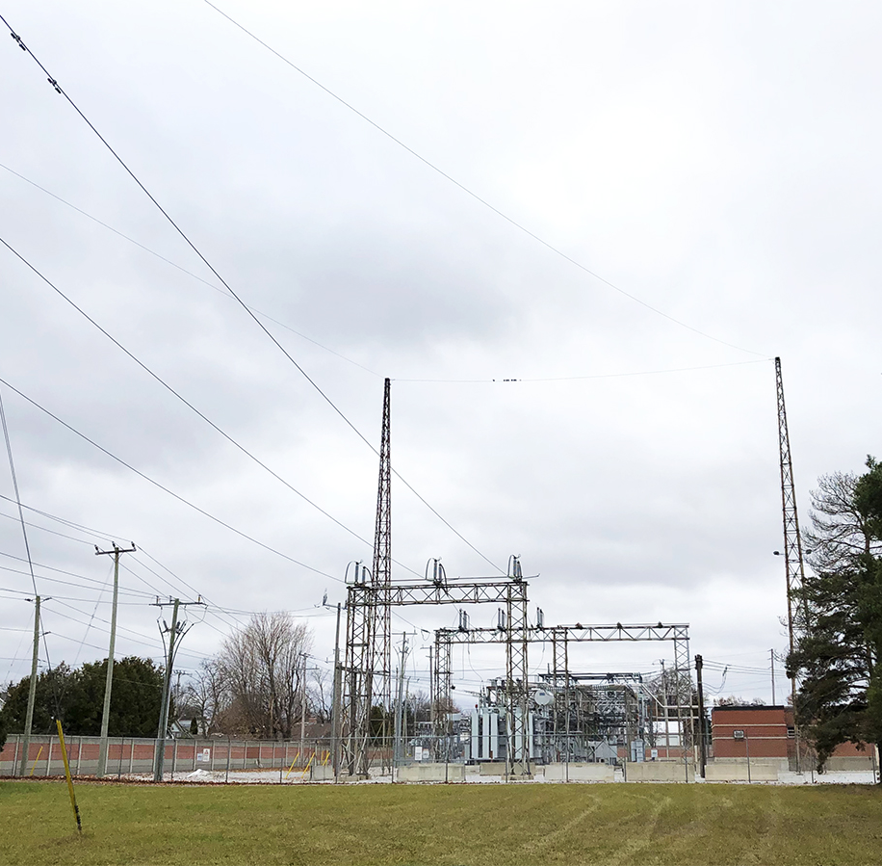
The Project
In order to ensure the continued reliability of electricity supply to the area, Hydro One needs to replace critical equipment at Tillsonburg Transformer Station and along the transmission line that connects to Cranberry Junction.
The project is subject to the Class Environmental Assessment for Minor Transmission Facilities (Hydro One, 2016) process, in accordance with the Ontario Environmental Assessment Act
This project is being assessed through a Class EA Screening Process
Key components to this process include:
  Consultation with Indigenous communities, elected officials, government officials and agencies and potentially affected and interested persons; and
  Identification of potential environmental effects of the project and mitigation measures
3

Slide 4
Project Maps
4

Slide 5
Project Maps
5

Slide 6
How the System Works

Slide 7
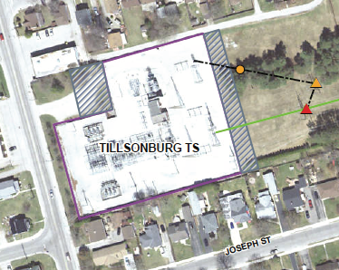
Proposed Station Work
The project will include replacing critical equipment both inside and just outside the station perimeter.
Inside the station:
The replacement and reconfiguring of end-of-life station equipment.
Around the station/on the corridor:
The station footprint will need to be expanded by approximately 10 metres to the east and approximately 20 metres to the west at the current station entrance.
On the corridor, the existing three-pole wood structure will be replaced as shown in red.
One or two additional structures will also be installed, as shown in orange.
7

Slide 8
Proposed Line Work
Along the transmission line between Tillsonburg TS and Cranberry Junction, work will include replacing and/or modifying select wood pole structures, conductor (wire) and insulators.
8

Slide 9
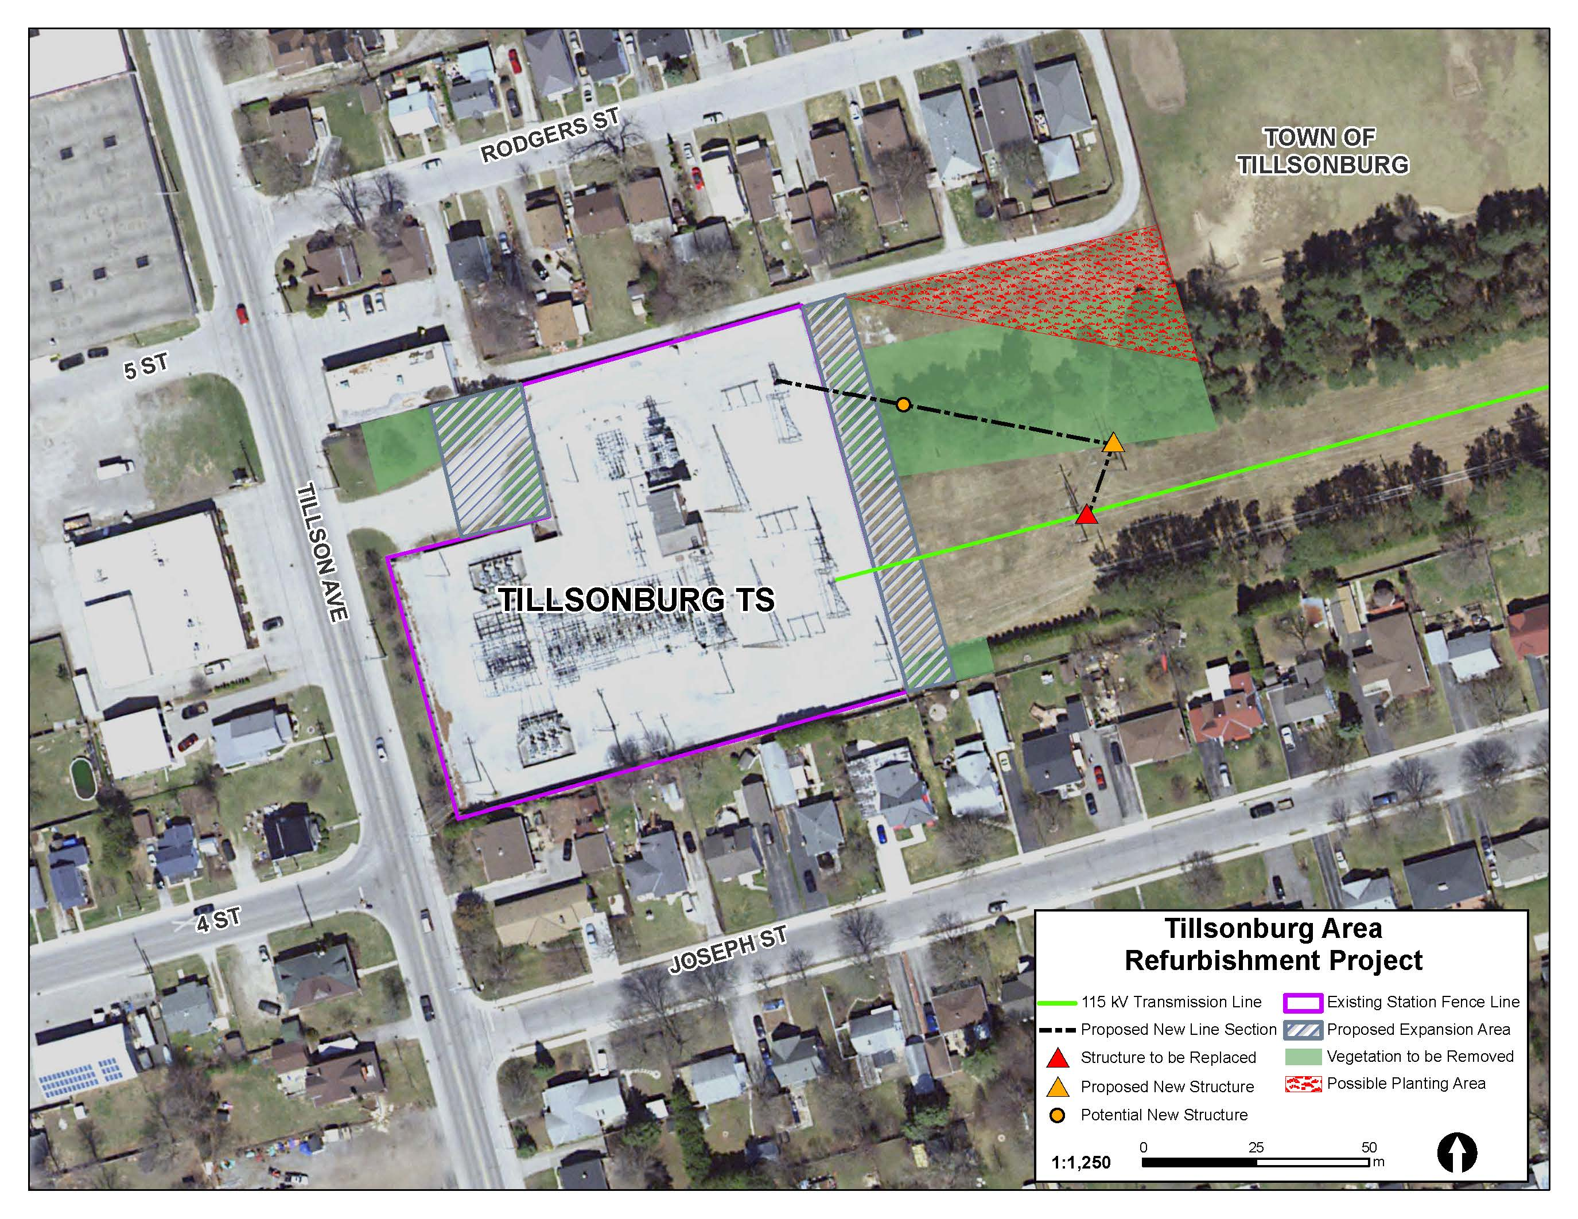
  Vegetation Removal

Slide 10



What to Expect
To facilitate the proposed construction, community members can expect:
CONSTRUCTION
Increased noise, personnel, vehicles, and dust
A fenced material storage area would be installed on the corridor east of the station for the duration of construction
The station wall would be expanded
VEGETATION AND REPLANTING
To accommodate the proposed station expansion and new line structures, vegetation removal would be required
Hydro One is working to identify opportunities for replanting following construction
Bird boxes will be identified and relocated when necessary
TEMPORARY UTILITY DISRUPTIONS
Temporary planned power interruptions are expected in 2021. You will be notified in advance by your local electricity distributor, Tillsonburg Hydro.
Through the Class EA, we are looking for opportunities for planting following construction. Please share your input with our staff via email or voicemail!
10

Slide 11
Timeline
Activity | (Anticipated) Timing
Notice of Commencement of the Class Environmental Assessment | February 2020
Project consultation and environmental evaluation | Ongoing
Online Community Engagement and Collection of Feedback | July 2020
Notice of Completion of the Class Environmental Assessment –filed with the MECP | August 2020
Construction Start | October 2020
Anticipated Construction Completion | Summer 2022
Replanting and bird box relocation in select areas | Following the end of construction and at an appropriate time of year
Anticipated Project Completion and Material Storage area removed | Fall 2022
11

Slide 12
THANK YOU FOR JOINING US TODAY!
Your input is important to us.
To provide comments or ask any questions, please fill out an online comment form, or contact the Community Relations team at 1.877.345.6799 or Community.Relations@HydroOne.com
12

